Slide 1
INTERNATIONAL PROJECT MANAGEMENT- SPRINT 3
Team- IPM Workshop-1
Presented by:
Aditya DAS
Jehad MELLAD
Poulomi NANDY
Jonathan MALLET

Slide 2
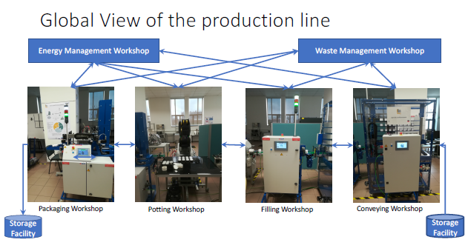
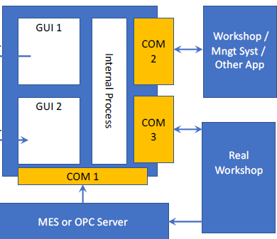
Global View and Architecture:

Slide 3
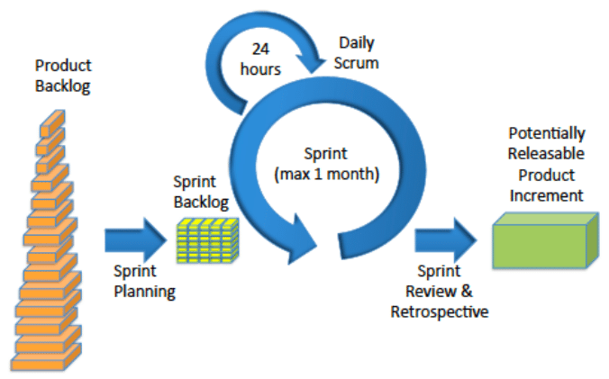
Scrum methodology

Slide 4
Scrum Elements
Roles:
Owners:
Prof. Olivier Boissier
Prof. Pierre Maret
Scrum master
Poulomi NANDY
Team members
Jonathan MALLET
Aditya DAS
Jehad MELLAD
List:
Product Backlog:
Sprint backlog
Impediments list

Slide 5
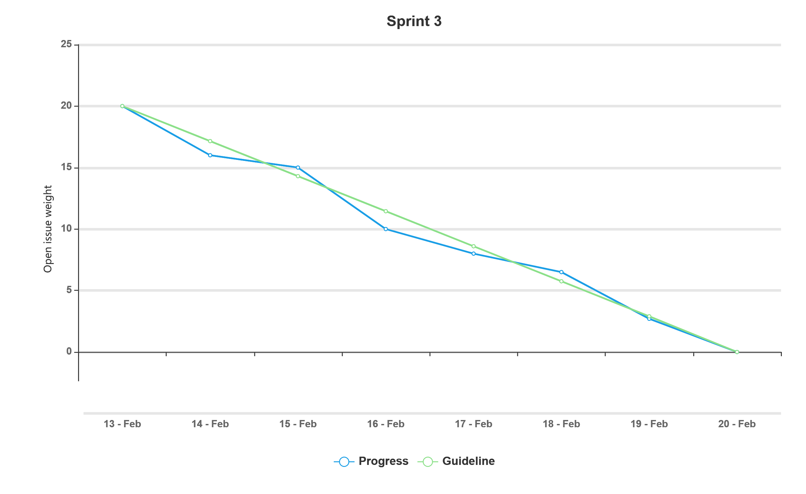
BurnDown Chart:

Slide 6
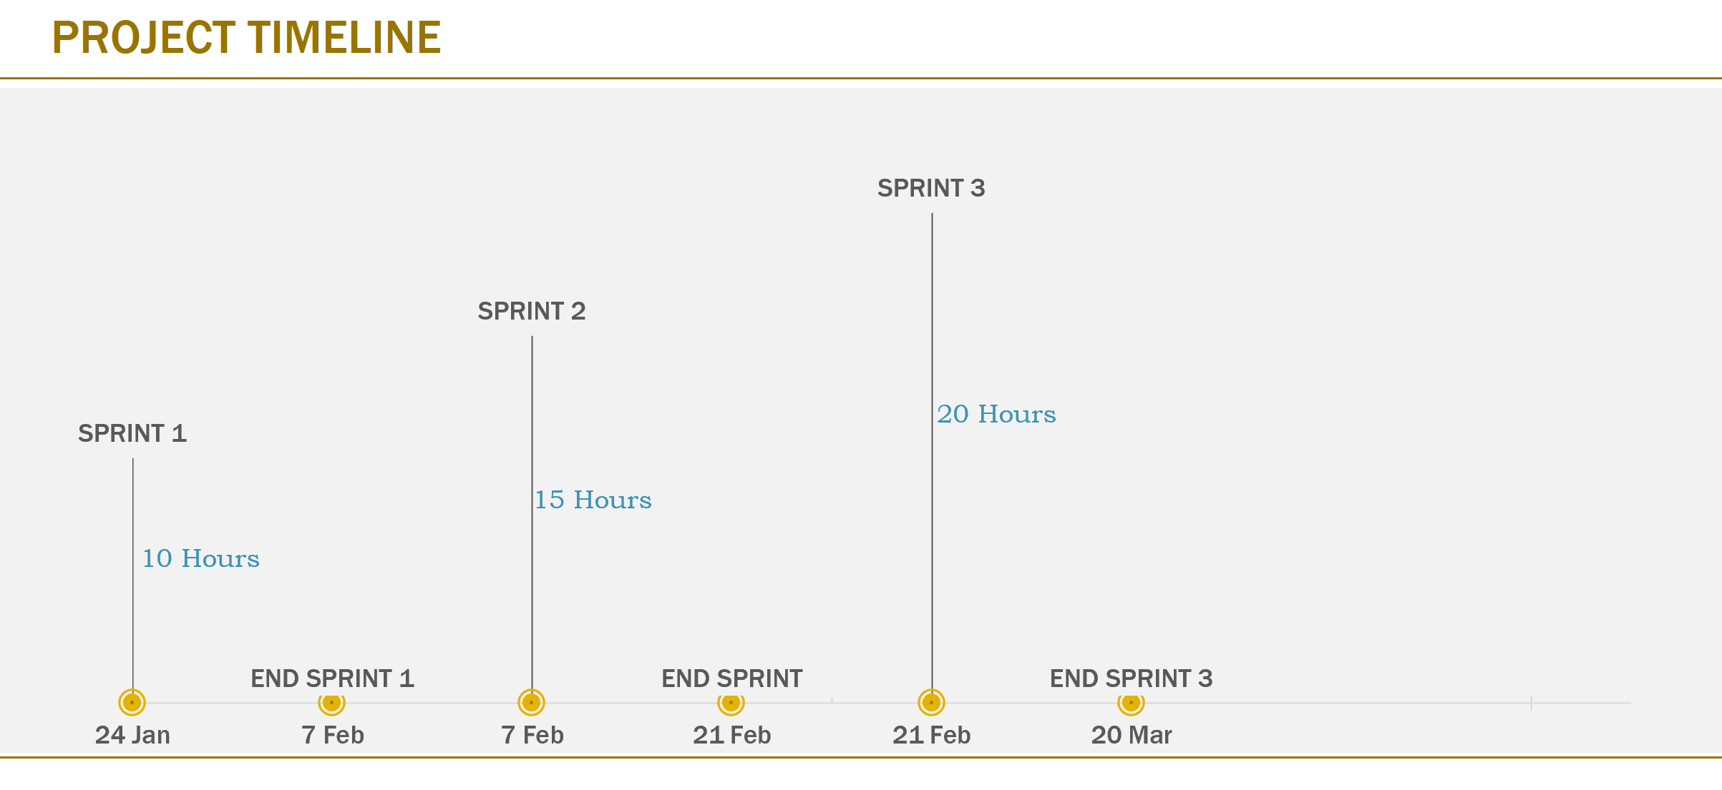

Slide 7
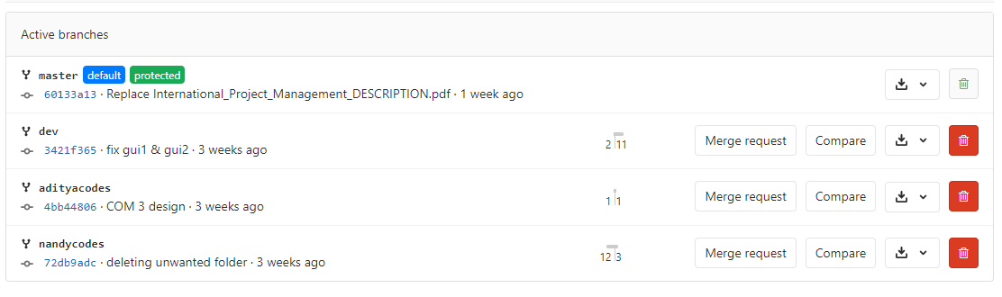
GITLAB Repositories

Slide 8
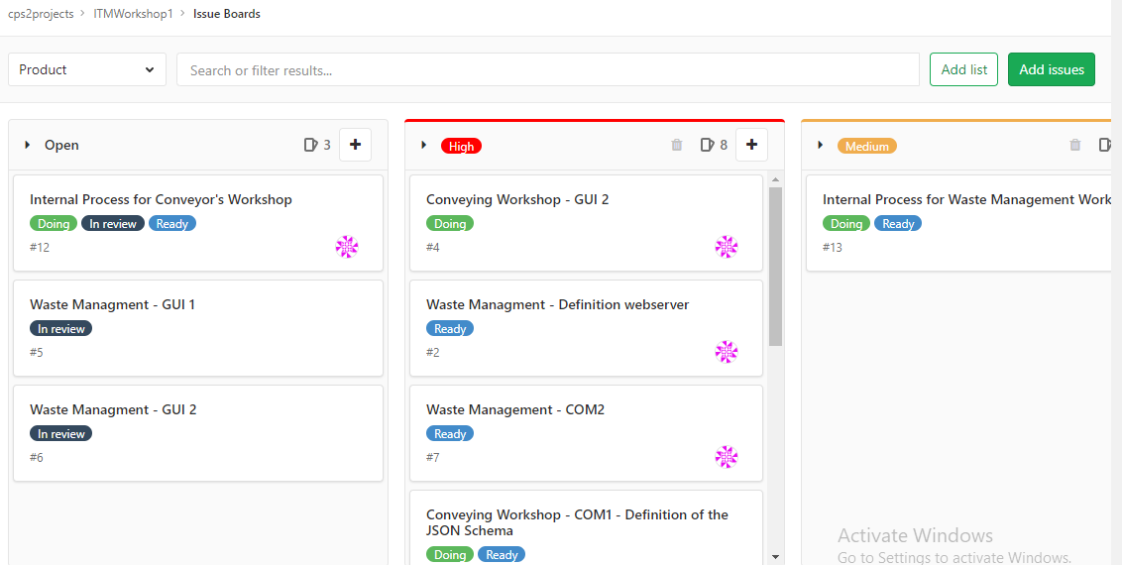
GITLAB ISSUE BOARD:

Slide 9
Works Done already in different Sprints:
SPRINT- 1:
GUI 1 & 2(HTML and CSS)
COM 3(Python Flask).
SPRINT-2:
Connecting GUIs to Server .(Socket i.o)
Structuring Conveying Workshop(Flowchart)
Implemented Conveying Workshop(Python)
Com 2

Slide 10
For this Sprint:
Collected JSON data from other Workshops.
Waste Management programmed.
Modified conveying workshop.
Com 1(OPC server- Client interaction)
Com 3( communication with real workshop)

Slide 11
Waste Management:How it works:
This is a part of Internal process:
Getting JSON data from all the workshops.
Display the workshop name
Display the status.

Slide 12
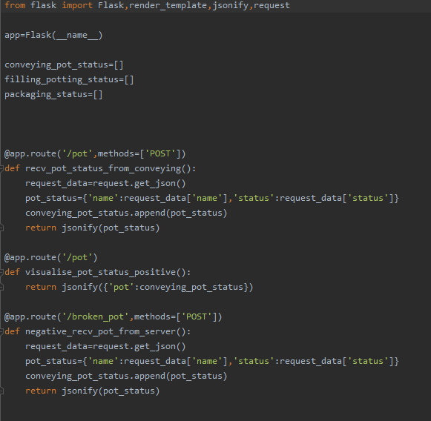
Waste Management Source Code:

Slide 13
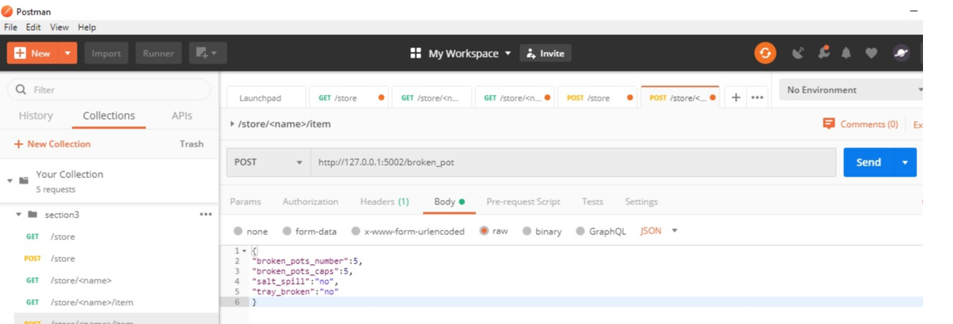
Output from Waste Management:
Json output:

Slide 14
Conveying Workshop(modified):
In the last code the output was terminal one.
The new souces code can retrive inputs and display outputs to GUIs.
The code has open API, if we give JSON data
it would process and show the output.

Slide 15
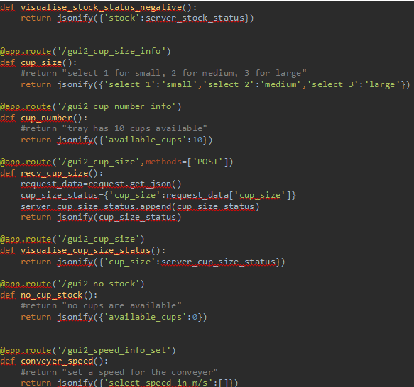
Conveying WorkShop Source Code:

Slide 16
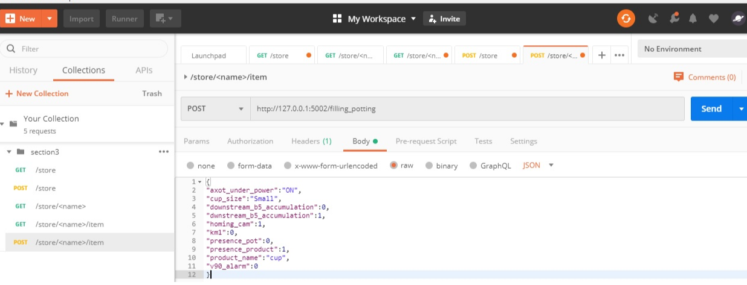
O/P Conveying Workshop:

Slide 17
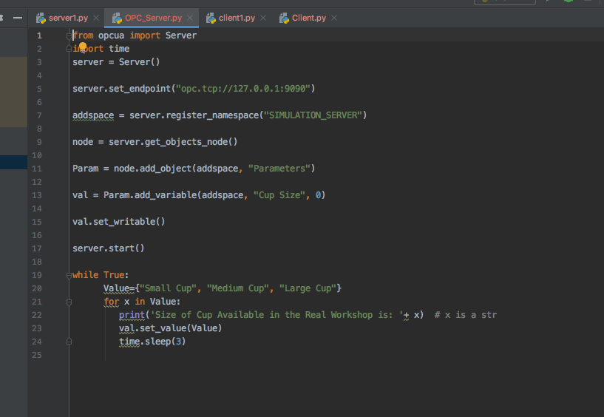
COM 1: OPC Client-Server Simulation

Slide 18
COM-1: Brief Explanation
Takes in values from the Real Workshop
Stores them in a temporary server Database
Uses Client-Server network paradigm to form a necessary communication protocol with the internal process.

Slide 19
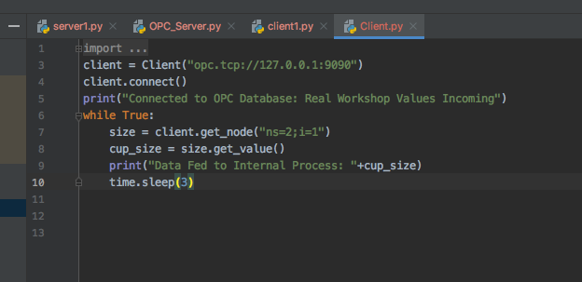
COM-3: API Interface to Communicate with Real Workshop

Slide 20
COM-3: Briefly Speaking?
Takes in values from the Real Workshop.
Sends them to the internal process.
In case of Conveyor’s Belt such values will entail: Cup Sizes - Small Cups, Medium Cups, Large Cups.
For Waste Management Systems, these will chiefly be: Broken Pots, liquid spills, broken trays, etc.

Slide 21
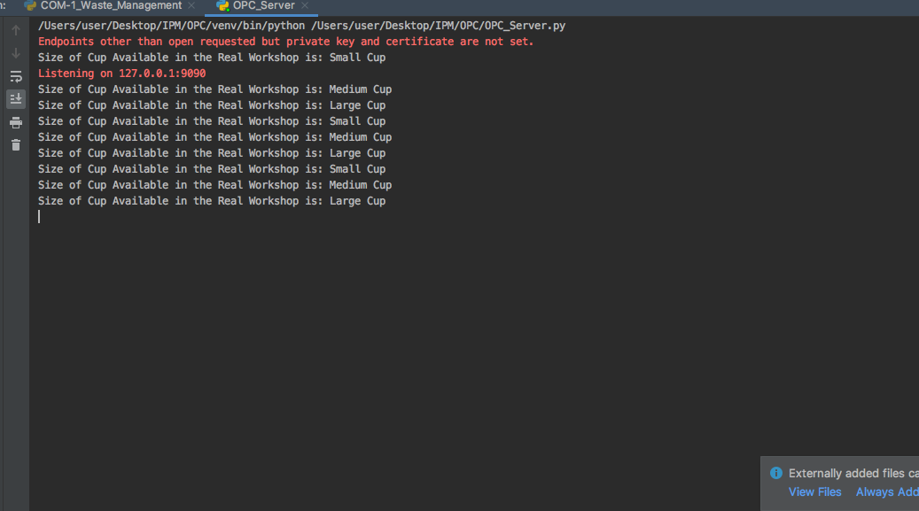
Sample Output Simulation

Slide 22
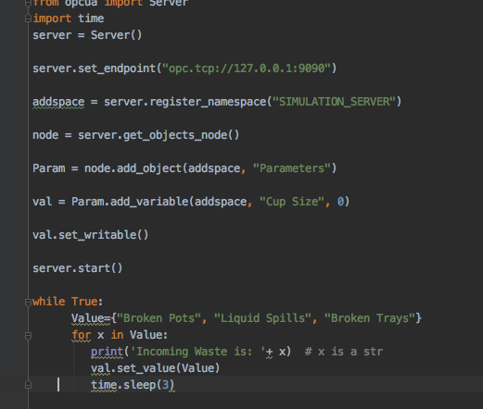
Instance of the same in the Waste Management System.

Slide 23
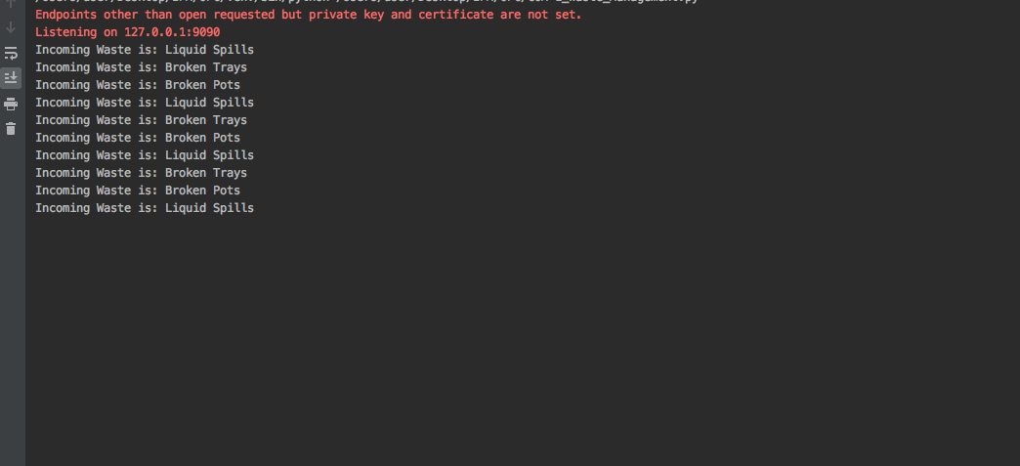
OUTPUT SIMULATION

Slide 24
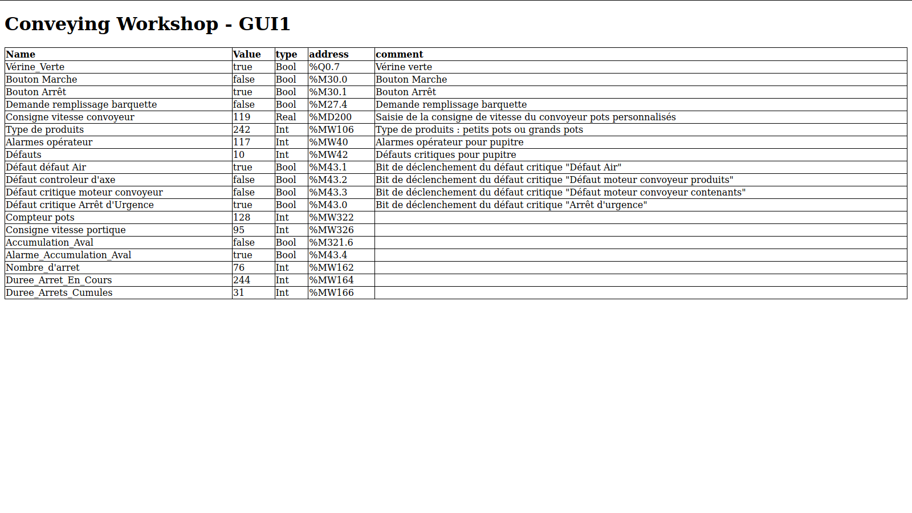
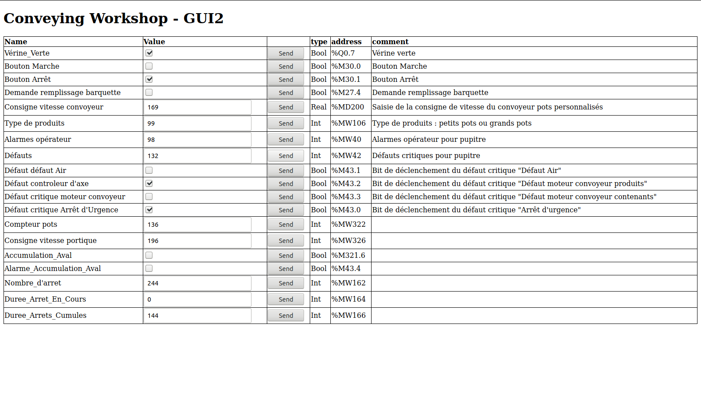
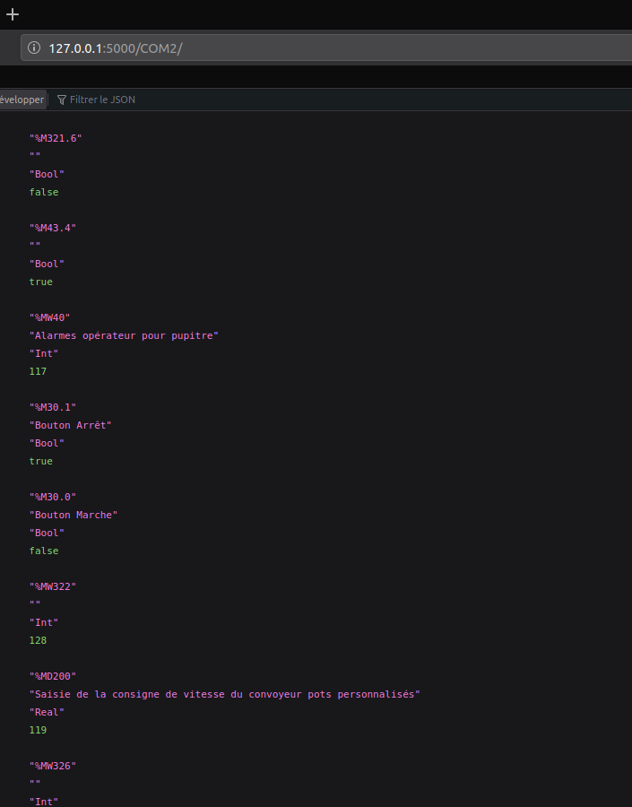
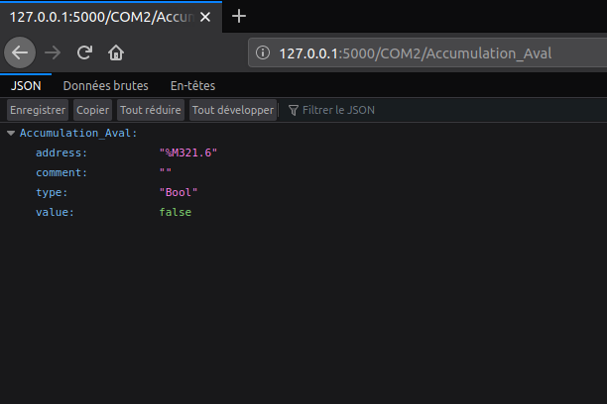
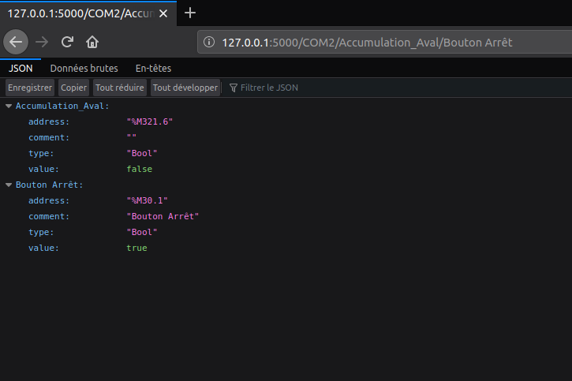
Interfaces

Slide 25
Difficulties & Improvements:
Once the GUI was designed, in implementation we faced difficulties.
Internal process was designed very easily and implemented successfully. But the output was in terminal, we had to modify the codes again to implement socket i.o program.
We faced synchronisation difficulties between the internal process and the communication protocols.

Slide 26
Thank you for your attention

